Slide 1

COMPUTER NETWORKING
LAB 2

Slide 2
Basic device navigation and configuration

Slide 3
OBJECTIVES
Configure device system parameters including device name and the system time.
Configure the console port idle timeout duration.
Configure the login information.
Configure the login password.
Save configuration files.
Configure IP addresses for router interfaces.
Test the connectivity between two directly connected routers.
Restart a device using VRP.

Slide 4
Design a topo consist of 1 switch and 2 PCs:
- use ipconfig
-ping
The screenshot the command panel.

Slide 5
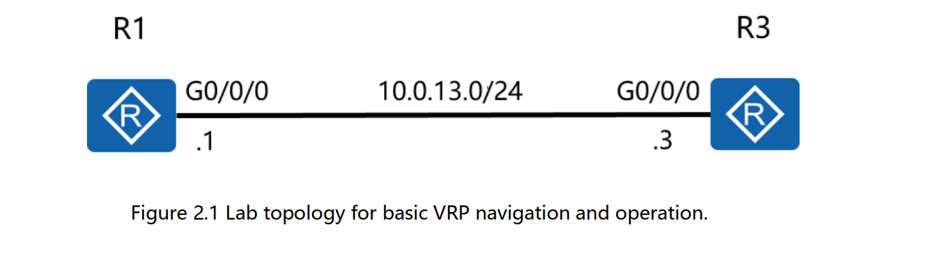
Topology

Slide 6
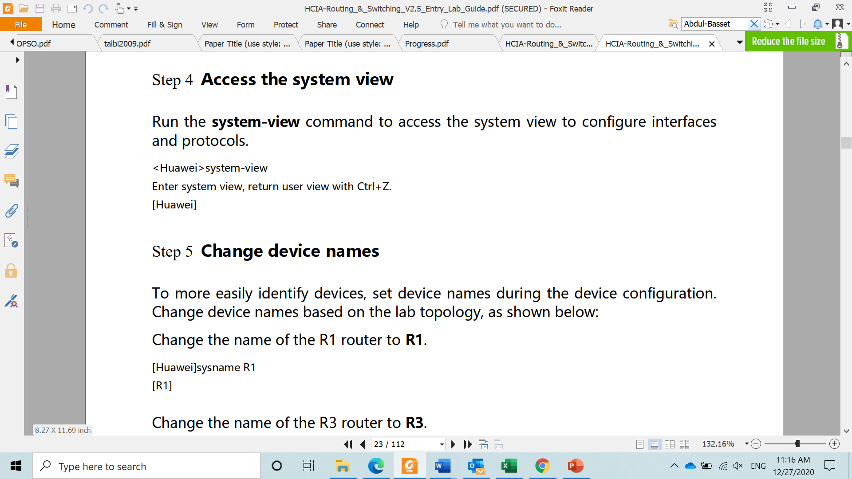
Basic device configuration
Run the system-view to access the system view to configure interfaces and protocols
Change the devices name based on the lab topology using sysname R1

Slide 7
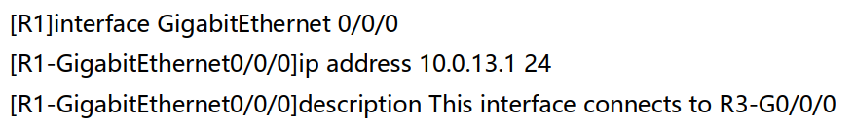
Basic device configuration
Configure IP address for the Gigabitethernet 0/0/0 interface of R1 using int gigabitethernet 0/0/0. the subnet mask can be configured using 255.255.255.0 or base on the subnet mask prefix
(int gigabitethernet 0/0/0) > (ip address 10.0.13.1 24)

Slide 8
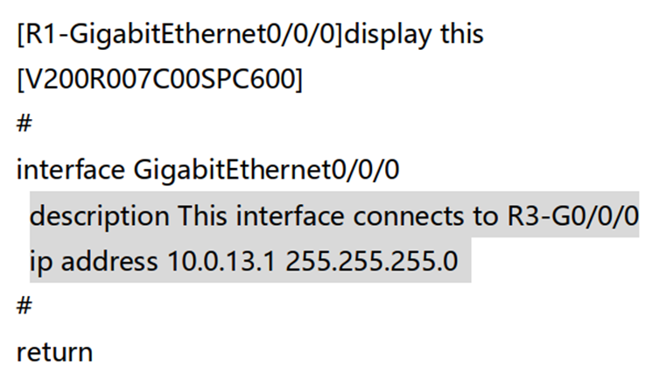
Basic device configuration
Run the display this to check the configuration results at the current interface view.
Run the display interface command to view the interface description.
After completing the configuration, run ping command to test the connection between R1 and R3.

Slide 9
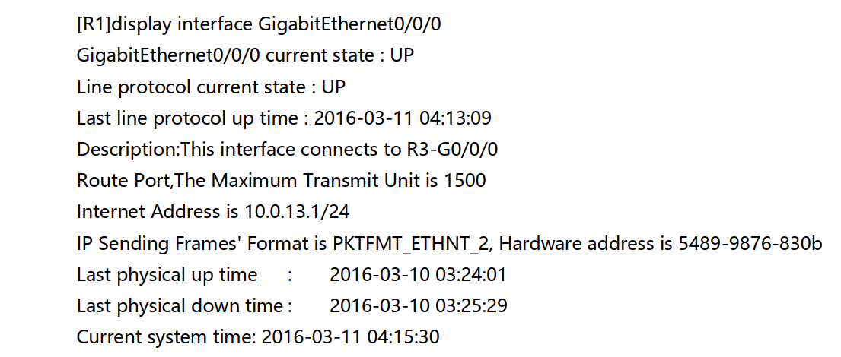
Basic device configuration

Slide 10
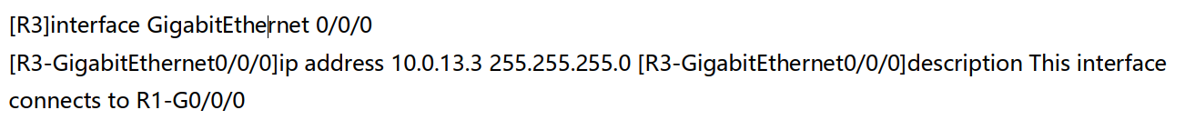
Basic device configuration
once the status has been verified, configure IP address and description for the interface of R3

Slide 11
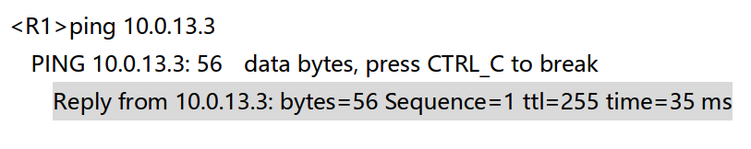
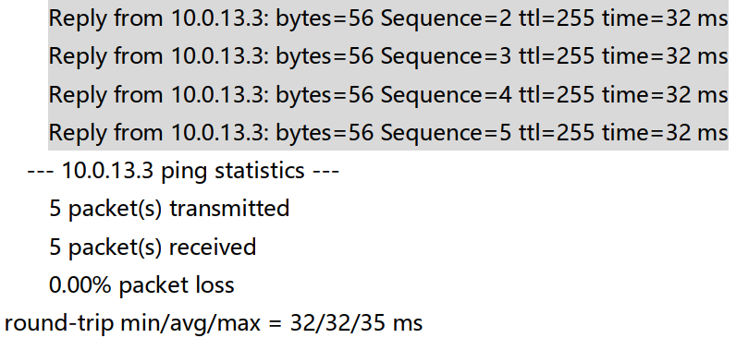
Basic device configuration
After completing the configuration, run ping command to test the connection between R1 and R3.
Save the current configuration file using save then Y.
Attempt to display the saved configuration files. (display saved-configuration)

Slide 12
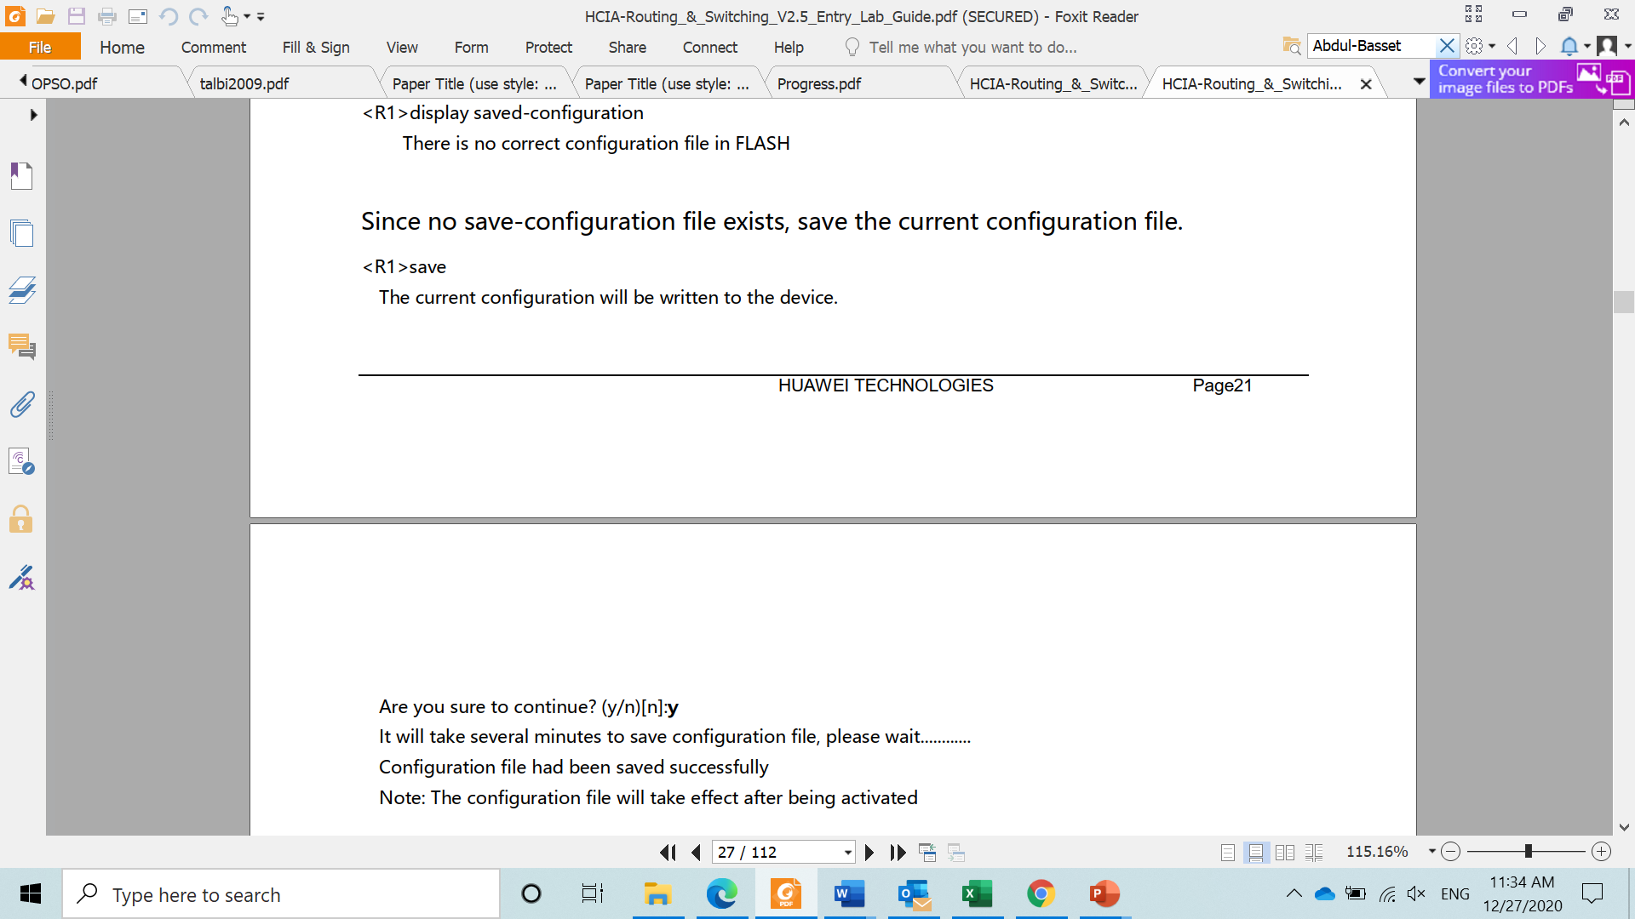
Basic device configuration
Save the current configuration file using save then Y.
Attempt to display the saved configuration files. (display saved-configuration)

Slide 13
Command's abbreviations
Command | Abbreviation
System-view | sys
Interface gigabitethernet | Int g (int g 0/0/0)
Ip address | Ip add (ip add 10.0.13.1 24)
Display | Disp (disp interface)
Quit | q
Save

Slide 14
Thank you

